Slide 1
Archiving and Purging Data Using Azure Data Factory
--Sushil Nandalal Marathe

Slide 2
Contents
1. Introduction
2. Project Focus Areas
3. Objectives
4. System Design
5. Folder Structure
6. Architecture Diagram
7. Implementation
8. Pipeline Steps
9. Conclusion

Slide 3
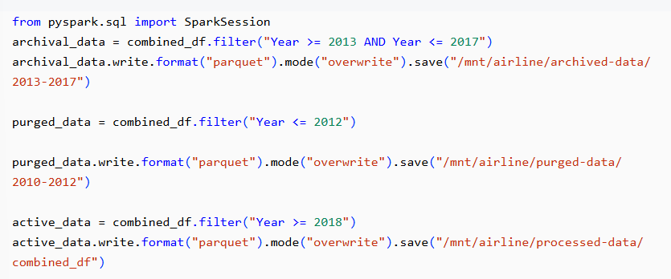
Introduction
In the era big data, organizations are constantly generating and managing large volumes of data. To ensure smooth operations and optimized storage usage, it is crucial to archive historical data and purge obsolete data efficiently. This project was undertaken to design and implement an automated solution for archiving and purging datasets using Azure Data Factory (ADF). The project aimed to handle data generated between 2010 and 2020 of an Airline Loyalty Program.

Slide 4
Project Focus Areas
Archiving Historical Data
Purging Obsolete Data
Archiving historical data (2013–2017) into a dedicated storage location for long-term retention.
Purging older, obsolete data (2010–2012) while logging its details for audit purposes.
EDA on Relevant Data
Automation
Performing EDA on relevant data (2018-2020) based on selected use-case.
Automating the entire process to reduce manual intervention.

Slide 5
Objectives
1. Clean Data
Process raw data stored in the raw-data container, clean it, and store the output in the processed-data container as Parquet files.
2. Archive Data
Move historical data (from specific years) to a dedicated archival location using cost-effective cool storage.
3. Purge Data
Remove obsolete data while logging its metadata for traceability.
4. Automation
Design pipelines in Azure Data Factory to automate the cleaning, archiving, and purging workflows.
5. Cost Optimization
Leverage separate storage accounts for archived and purged data containers, utilizing cool storage for reduced costs.

Slide 6
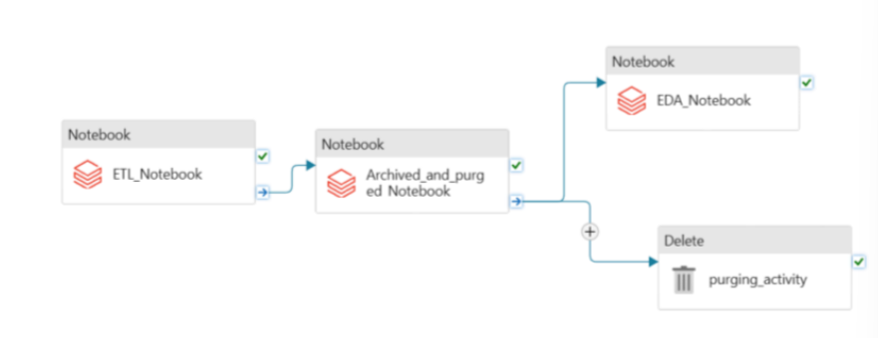
System Design
The solution consisted of a main pipeline orchestrated using Azure Data Factory that performed cleaning, archiving and purging activity effectively.

Slide 7
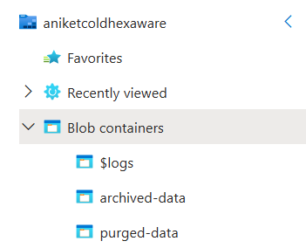
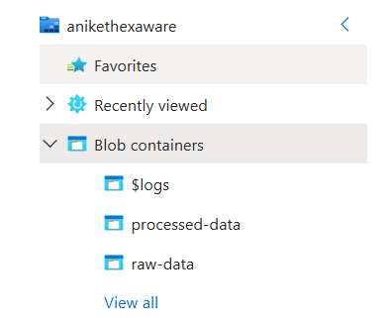
Folder Structure
The project used the following folder structure across multiple Azure Blob Storage accounts: raw-data (Hot Storage Account): Stores unprocessed raw datasets. processed-data (Hot Storage Account): Stores cleaned data in Parquet format for further processing. archived-data (Cool Storage Account): Stores archived data for long-term retention. purged-data (Cool Storage Account): Temporarily holds obsolete datasets before deletion. This segregation ensured optimized performance, cost savings, and compliance with data lifecycle policies.

Slide 8
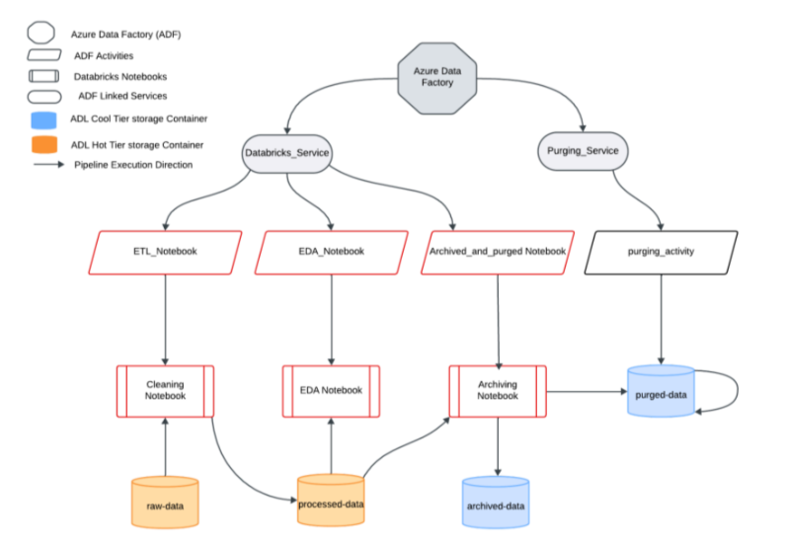
Architecture Diagram
[Architecture Diagram of the solution illustrating how the data flows through different components]

Slide 9
Implementation
1. Data Cleaning Notebook
The first step in the pipeline. It processed raw data to a cleaned format for downstream operations.
2. Data Archiving Notebook
The second step. It moved historical data to cost-efficient cool storage.
3. EDA Notebook
Designed to analyze a subset of relevant data (2018–2020) and showcase a use case.
4. Data Purging Activity
Automated the removal of obsolete data from the processed-data container.
5. Pipeline Overview
The pipeline executed the notebooks sequentially, ensuring smooth data transformation, archival, and analysis.

Slide 10
Pipeline Steps
Data Cleaning Notebook
Data Archiving Notebook
Reading raw data, applying transformations, and saving cleaned data in Parquet format.
Filtering data for archival and saving it in the archived-data container.
EDA Notebook
Data Purging Activity
Filtering relevant data (2018–2020), analyzing summer months (June–August), and visualizing insights.
Identifying and removing obsolete data (2010-2012) while logging details in an Azure SQL Database table named PurgedDataLogs.

Slide 11
Conclusion
The pipeline construction successfully automated the entire data lifecycle management, including cleaning, archiving, and purging, with minimal manual intervention. The solution ensured optimal storage usage, compliance with data lifecycle policies, and provided actionable insights through EDA.

